Slide 1

Graphs
Chris Piech
CS 106B
Lecture 20
Feb 24, 2016
CS 106B
2011

Slide 2

Who Do You Love
And how does Facebook know?

Slide 3
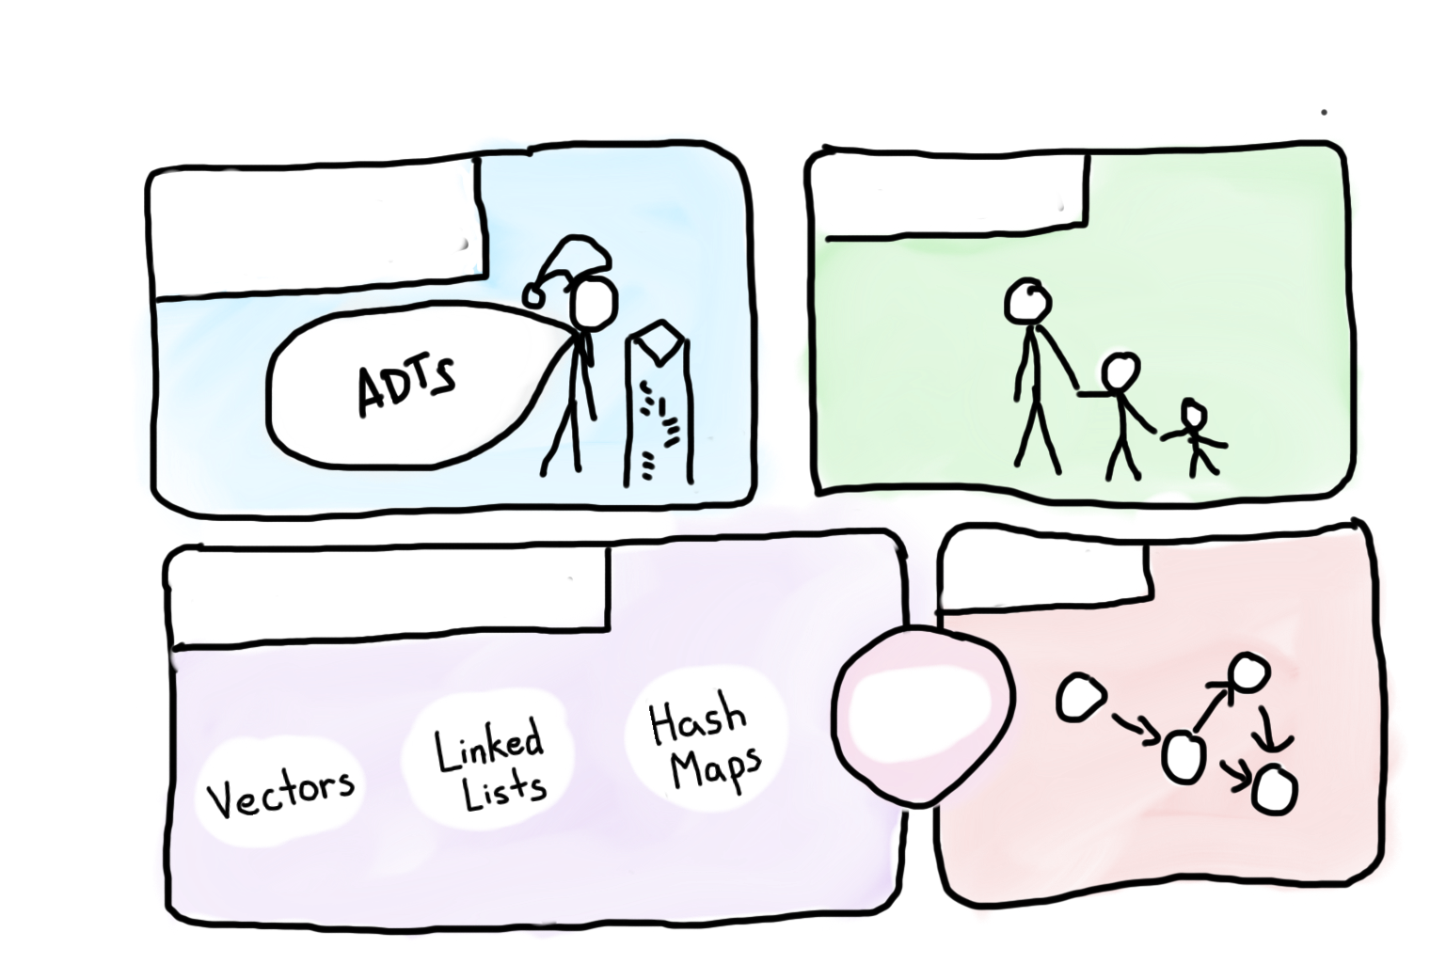

Course Syllabus
Intro to Abstractions
Recursion
Graphs
Under the Hood
Trees
You are here

Slide 4

Today’s Goal
Introduction to Graphs
Graphs in C++

Slide 5

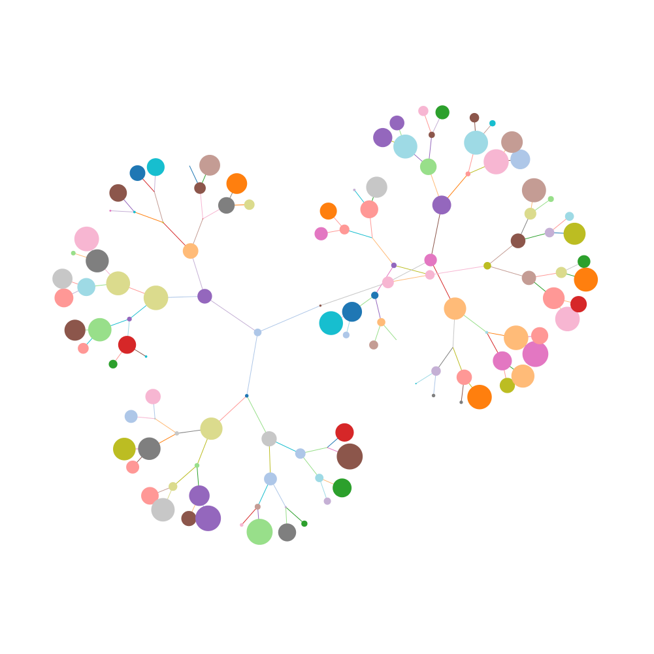
Today’s Route
Friday
Lover
Twitter
Graphs n
C++
Graphs
Graph River

Slide 6


Tree Definition
Only One Parent
No Cycles

Slide 7


Slide 8
Graph Definition
A graph is a mathematical structure
for representing relationships using nodes and edges.
*Just like a tree without the rules

Slide 9

We can have a family tree?

Slide 10
Not a Tree
Tywin
Jamie
Tyrion
Cersi

Slide 11
Not a Tree
Tywin
Jamie
Tyrion
Cersi
Joffrey

Slide 12
Not a Tree
Tywin
Jamie
Tyrion
Cersi
Joffrey

Slide 13
graph
We can have a family tree?

Slide 14
Simple Graph
struct Node{
string value;
Vector<Edge *> edges;
};
struct Edge{
Node * start;
Node * end;
};
struct Graph{
Set<Node *> nodes;
Set<Edge*> edges;
};

Slide 15
Simple Graph
struct Node{
string value;
Vector<Edge *> edges;
};
struct Edge{
Node * start;
Node * end;
};
We allow for more interesting edges
struct Graph{
Set<Node *> nodes;
Set<Edge*> edges;
};

Slide 16
Simple Graph
struct Node{
string value;
Vector<Edge *> edges;
};
struct Edge{
Node * start;
Node * end;
};
struct Graph{
Set<Node *> nodes;
Set<Edge*> edges;
};
We allow for more interesting edges

Slide 17
Simple Graph
struct Node{
string value;
Vector<Edge *> edges;
};
struct Edge{
Node * start;
Node * end;
double weight;
};
struct Graph{
Set<Node *> nodes;
Set<Edge*> edges;
};
We allow for more interesting edges

Slide 18
Simple Graph
A graph consists of a set of nodes connected by edges.

Slide 19
Simple Graph
A graph consists of a set of nodes connected by edges.

Slide 20
Graph Nodes
A graph consists of a set of nodes connected by edges.
Nodes

Slide 21
Graph Edges
A graph consists of a set of nodes connected by edges.
Edges

Slide 22
Directed Graph

Slide 23
Undirected Graph
CAN
MAN
RAN
MAT
CAT
SAT
RAT

Slide 24
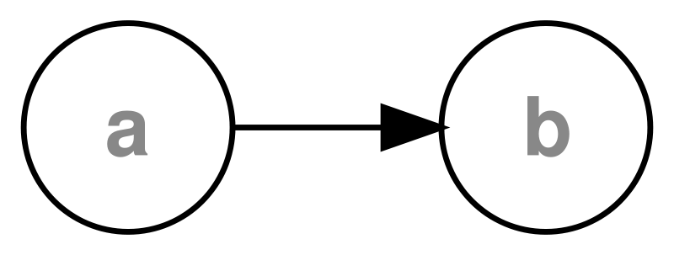
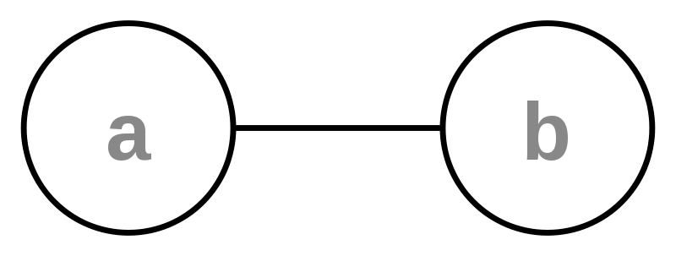
Directed vs Undirected

Slide 25
Weighted graphs
weight: Cost associated with a given edge.
example: graph of airline flights, weighted by miles between cities:
849
PVD
1843
ORD
SFO
142
802
LGA
1743
337
1387
HNL
2555
1099
LAX
1233
DFW
1120
MIA

Slide 26
You have seen this before…

Slide 27
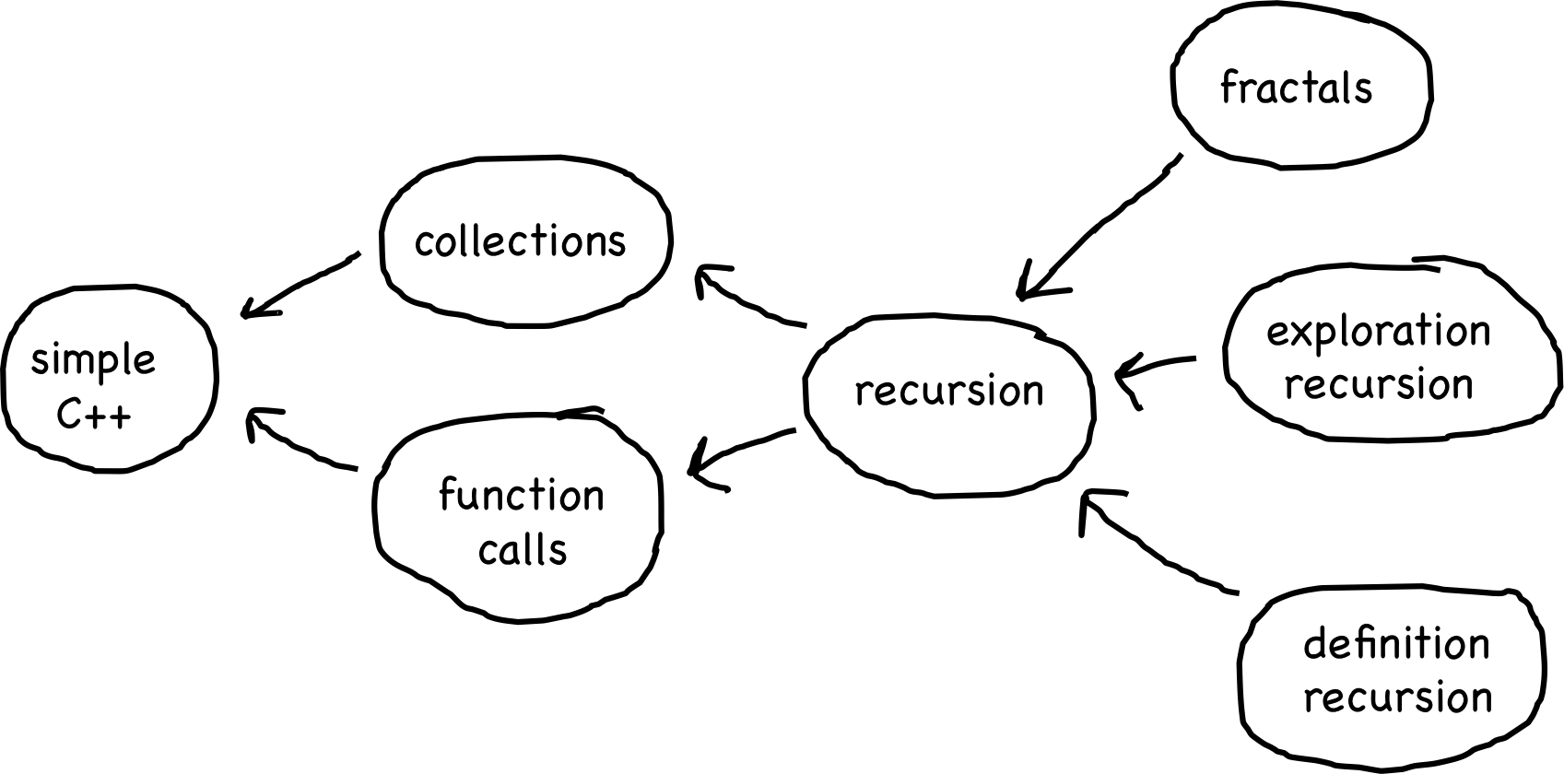
Prerequisite Graph

Slide 28
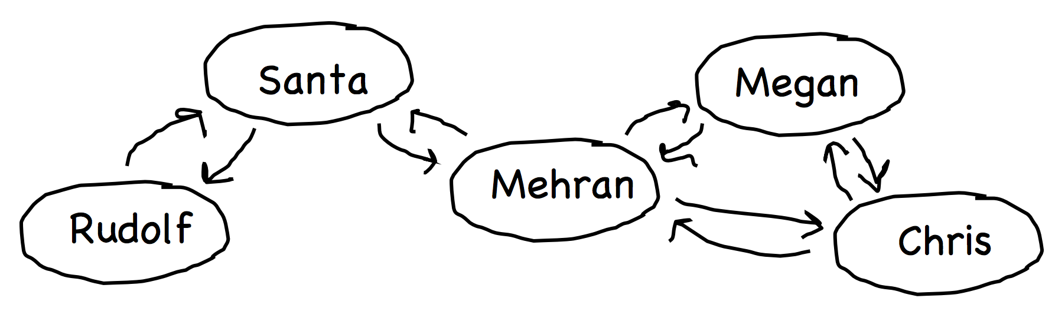
Social Network Graph

Slide 29
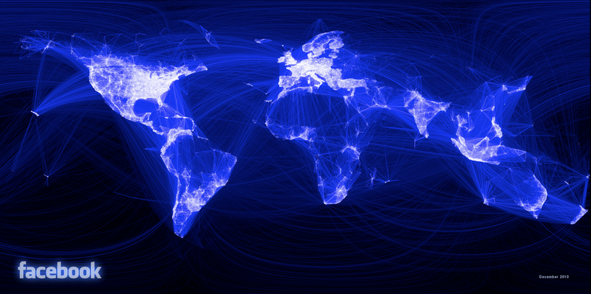
Social Network

Slide 30
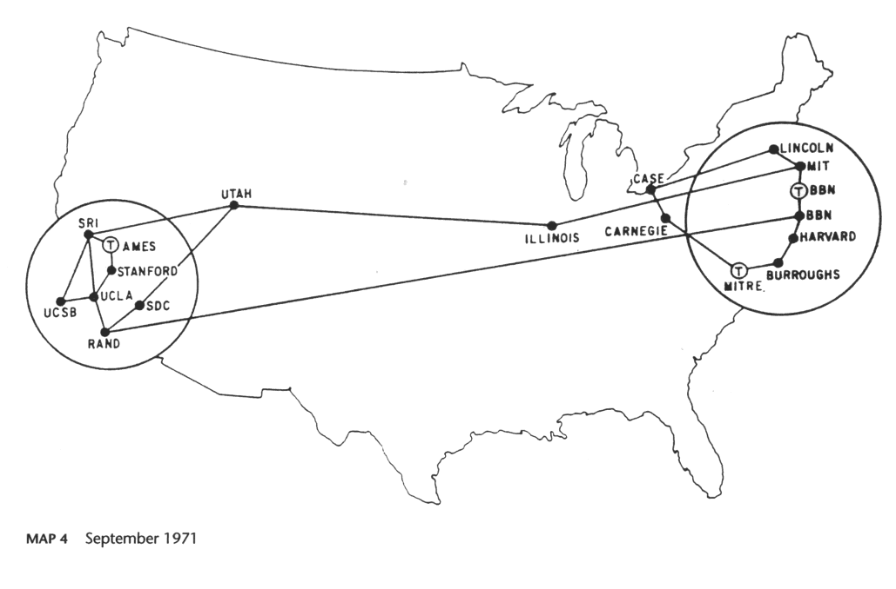
The Internet

Slide 31
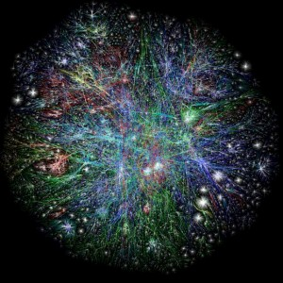
The Internet
10 to 20 billion

Slide 32
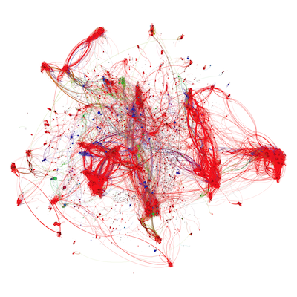
CS Assignments

Slide 33
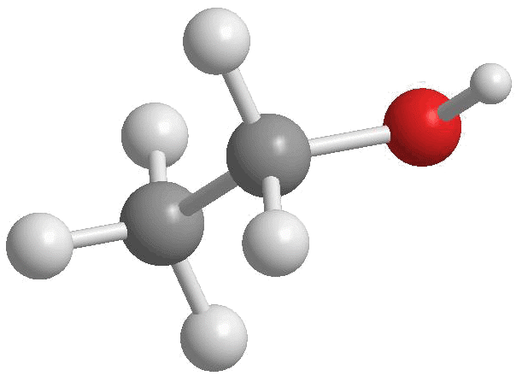
Chemical Bonds
http://4.bp.blogspot.com/-xCtBJ8lKHqA/Tjm0BONWBRI/AAAAAAAAAK4/-mHrbAUOHHg/s1600/Ethanol2.gif

Slide 34
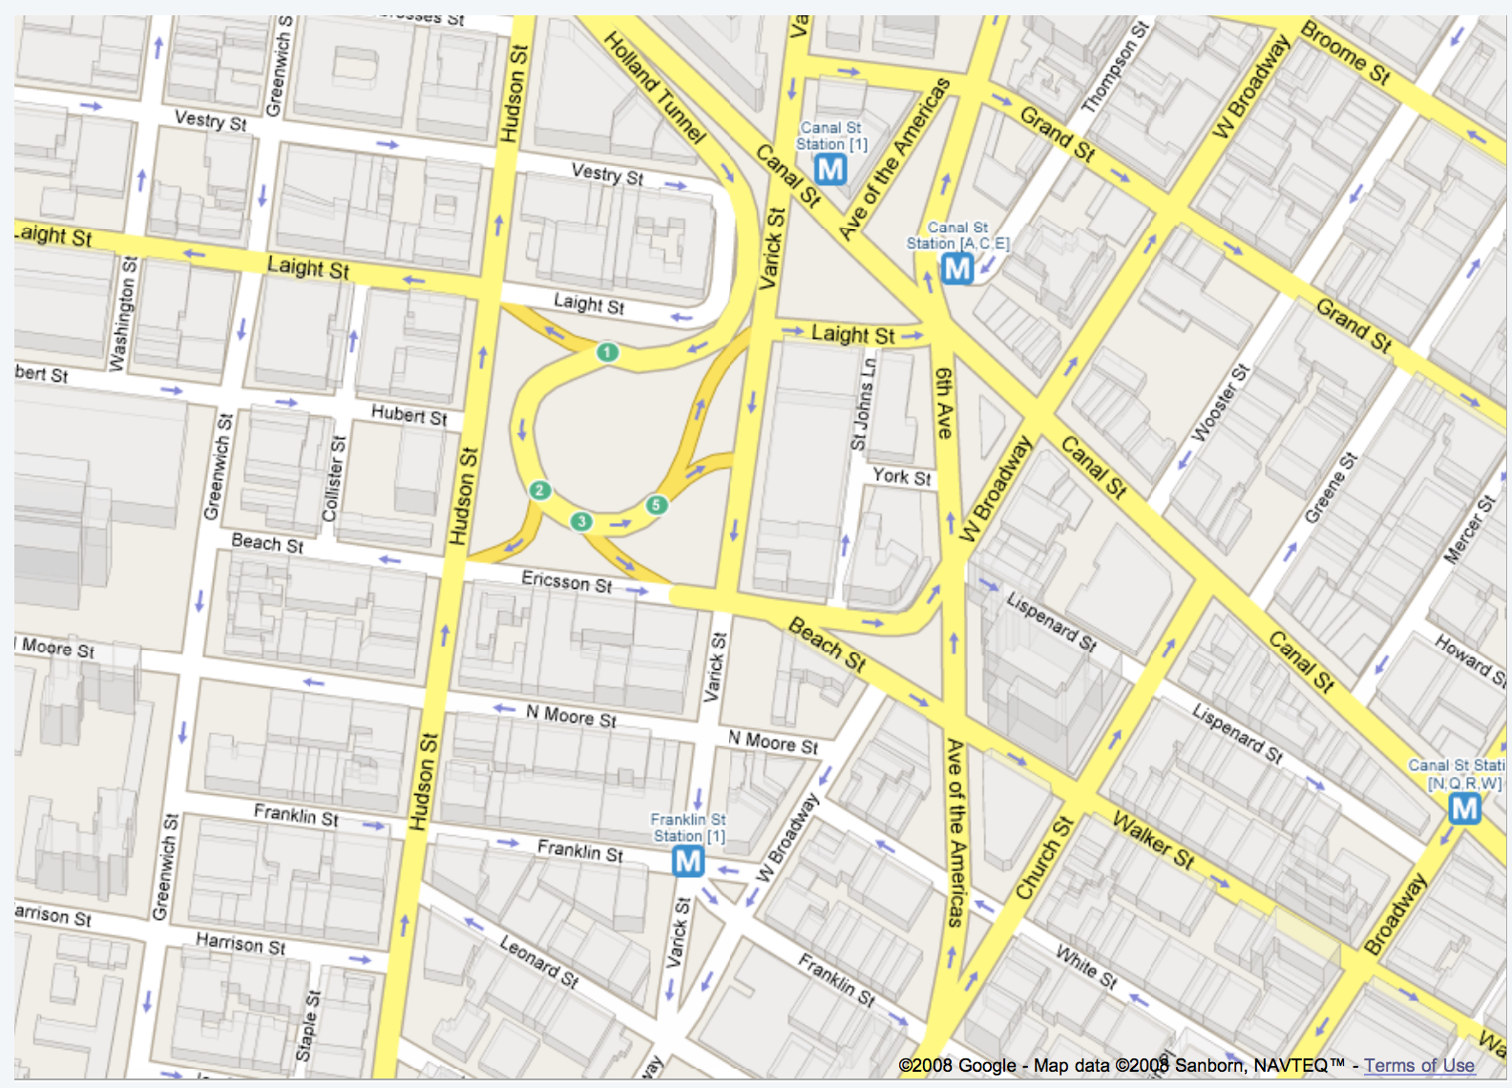
Road Map

Slide 35
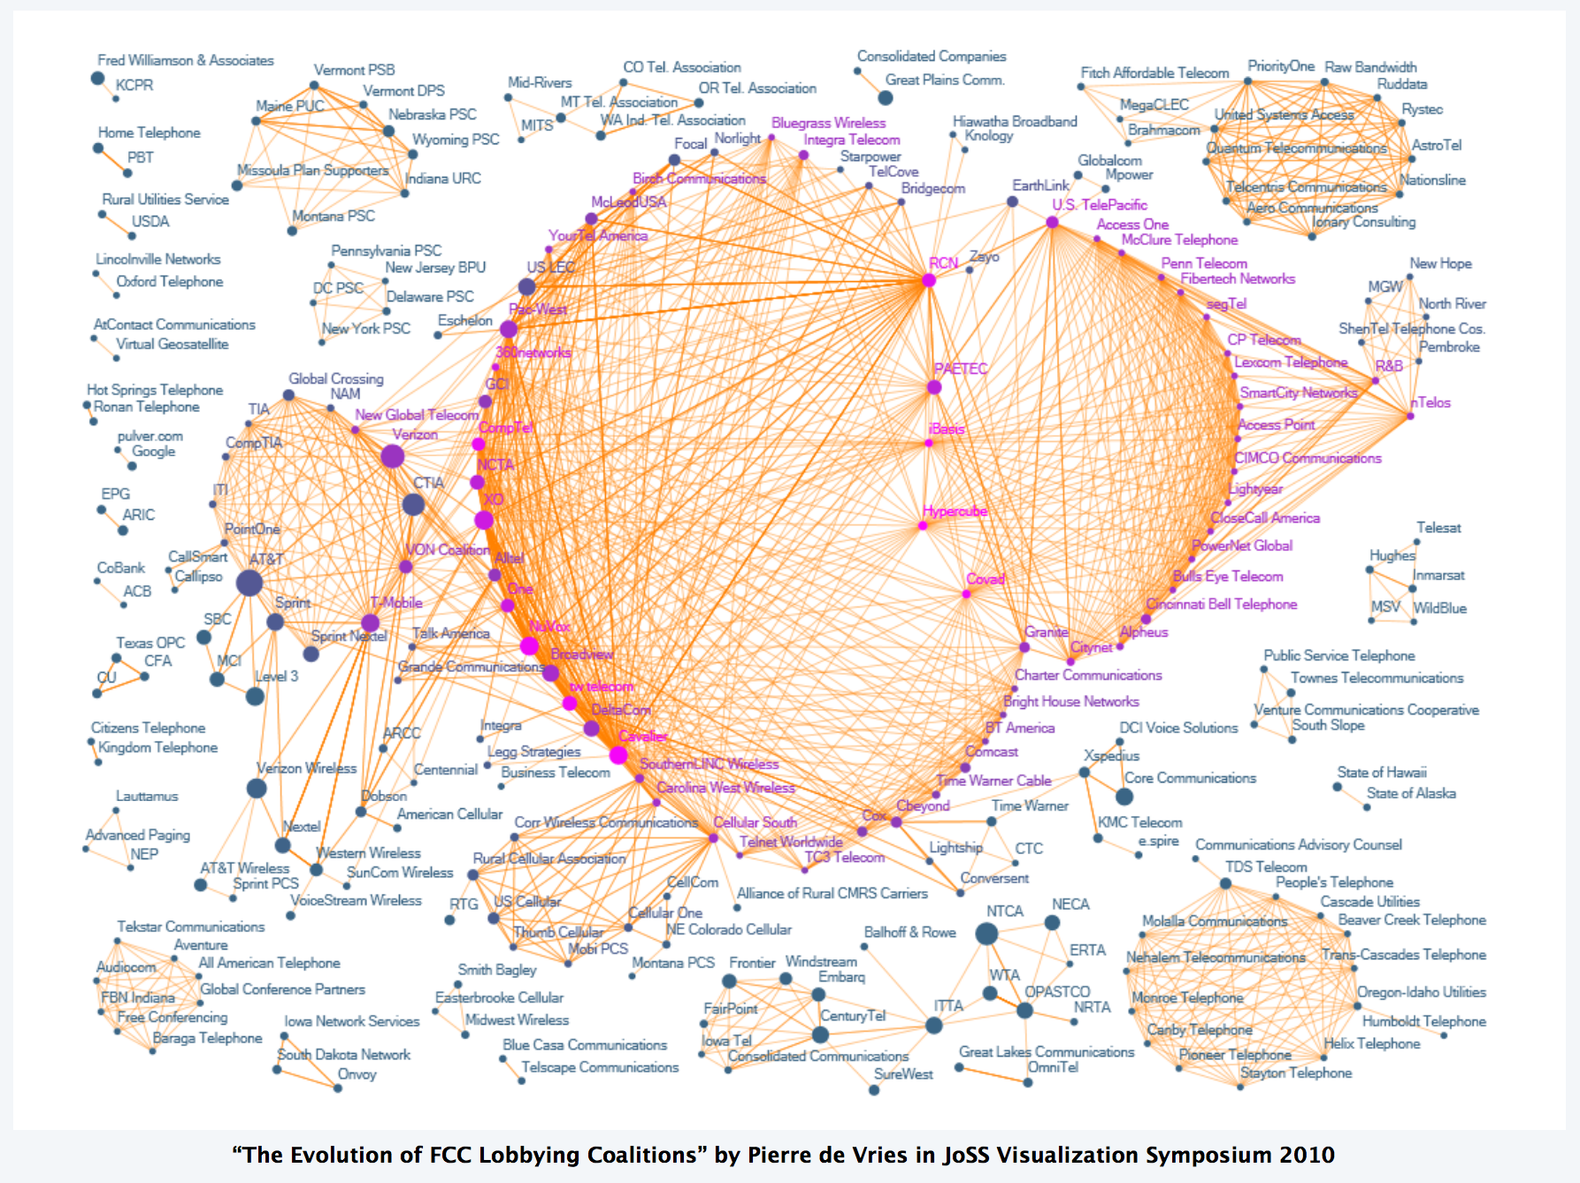
Corruption

Slide 36
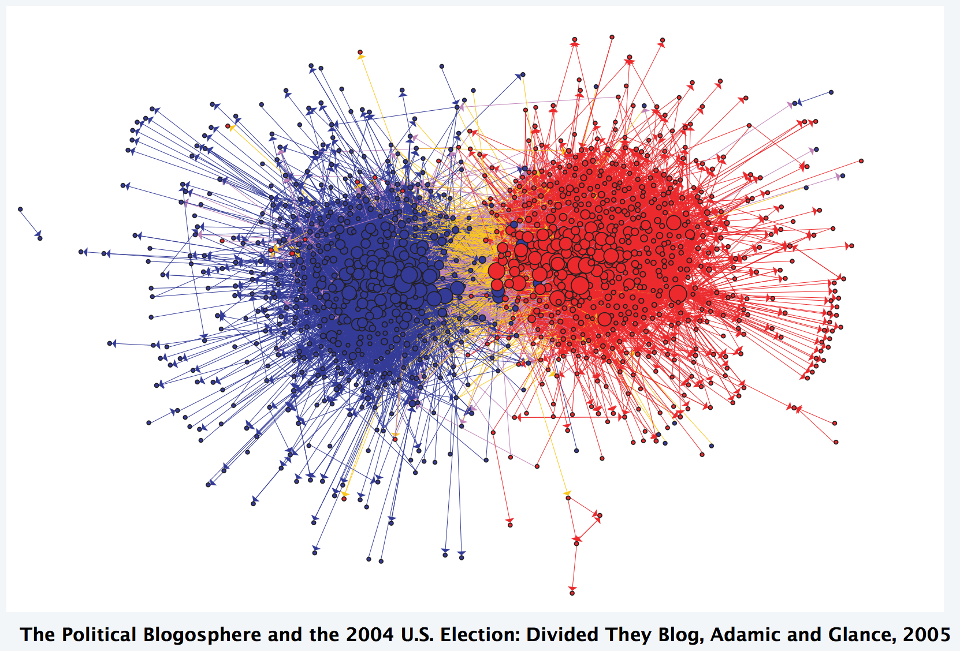
Partisanship

Slide 37
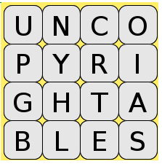
Boggle

Slide 38
Boggle

Slide 39
Boggle

Slide 40
Some terms:

Slide 41
Paths
path: A path from vertex a to b is a sequence of edges that can be followed starting from a to reach b.
can be represented as vertices visited, or edges taken
example, one path from V to Z: {b, h} or {V, X, Z}
What are two paths from U to Y?
path length: Number of vertices or edges contained in the path.
neighbor or adjacent: Two vertices connected directly by an edge.
example: V and X
V
a
b
U
d
X
Z
h
c
e
W
g
f
Y

Slide 42
Loops and cycles
cycle: A path that begins and ends at the same node.
example: {b, g, f, c, a} or {V, X, Y, W, U, V}.
example: {c, d, a} or {U, W, V, U}.
acyclic graph: One that does not contain any cycles.
loop: An edge directly from a node to itself.
Many graphs don't allow loops.
V
a
b
U
d
X
Z
h
c
e
W
g
f
Y

Slide 43
Reachability, connectedness
reachable: Vertex a is reachable from b if a path exists from a to b.
connected: A graph is connected if every vertex is reachable from every other.
complete: If every vertex has a direct edge to every other.
V
a
b
U
d
X
Z
h
c
e
W
g
f
Y
a
b
a
b
d
c
c
d
e

Slide 44
Today’s Route
Friday
Lover
Twitter
Graphs n
C++
Graphs
Graph River

Slide 45
Today’s Route
Friday
Lover
Twitter
Graphs n
C++
Graphs
Graph River

Slide 46
Stanford BasicGraph
The Stanford C++ library includes a BasicGraph class.
Based on an older library class named Graph
You can construct a graph and add vertices/edges:
#include "basicgraph.h"
...
BasicGraph graph;
graph.addVertex("a");
graph.addVertex("b");
graph.addVertex("c");
graph.addVertex("d");
graph.addEdge("a", "c");
graph.addEdge("b", "c");
graph.addEdge("c", "b");
graph.addEdge("b", "d");
graph.addEdge("c", "d");
a
b
c
d

Slide 47
BasicGraph members
#include "basicgraph.h" // a directed, weighted graph
g.addEdge(v1, v2); | adds an edge between two vertexes
g.addVertex(name); | adds a vertex to the graph
g.clear(); | removes all vertexes/edges from the graph
g.getEdgeSet() g.getEdgeSet(v) | returns all edges, or all edges that start at v, as a Set of pointers
g.getNeighbors(v) | returns a set of all vertices that v has an edge to
g.getVertex(name) | returns pointer to vertex with the given name
g.getVertexSet() | returns a set of all vertexes
g.isNeighbor(v1, v2) | returns true if there is an edge from vertex v1 to v2
g.isEmpty() | returns true if queue contains no vertexes/edges
g.removeEdge(v1, v2); | removes an edge from the graph
g.removeVertex(name); | removes a vertex from the graph
g.size() | returns the number of vertexes in the graph
g.toString() | returns a string such as "{a, b, c, a -> b}"

Slide 48
BasicGraph members
#include "basicgraph.h" // a directed, weighted graph
g.addEdge(v1, v2); | adds an edge between two vertexes
g.addVertex(name); | adds a vertex to the graph
g.clear(); | removes all vertexes/edges from the graph
g.getEdgeSet() g.getEdgeSet(v) | returns all edges, or all edges that start at v, as a Set of pointers
g.getNeighbors(v) | returns a set of all vertices that v has an edge to
g.getVertex(name) | returns pointer to vertex with the given name
g.getVertexSet() | returns a set of all vertexes
g.isNeighbor(v1, v2) | returns true if there is an edge from vertex v1 to v2
g.isEmpty() | returns true if queue contains no vertexes/edges
g.removeEdge(v1, v2); | removes an edge from the graph
g.removeVertex(name); | removes a vertex from the graph
g.size() | returns the number of vertexes in the graph
g.toString() | returns a string such as "{a, b, c, a -> b}"

Slide 49
Using BasicGraph
The graph stores a struct of information about each vertex/edge:
struct Vertex { struct Edge {
string name; Vertex* start;
Set<Edge*> edges; Vertex* finish;
double cost; double weight;
// other stuff // other stuff
}; };
You can use these to help implement graph algorithms:
Vertex * vertC = graph.getVertex("c");
Edge * edgeAC = graph.getEdge("a", "c");
a
b
3
c
d

Slide 50

Our First Graph
A
C
B

Slide 51
There are other representations…

Slide 52
… this is the one we are going to use.

Slide 53
Today’s Route
Friday
Lover
Twitter
Graphs n
C++
Graphs
Graph River

Slide 54
Today’s Route
Friday
Lover
Twitter
Graphs n
C++
Graphs
Graph River

Slide 55
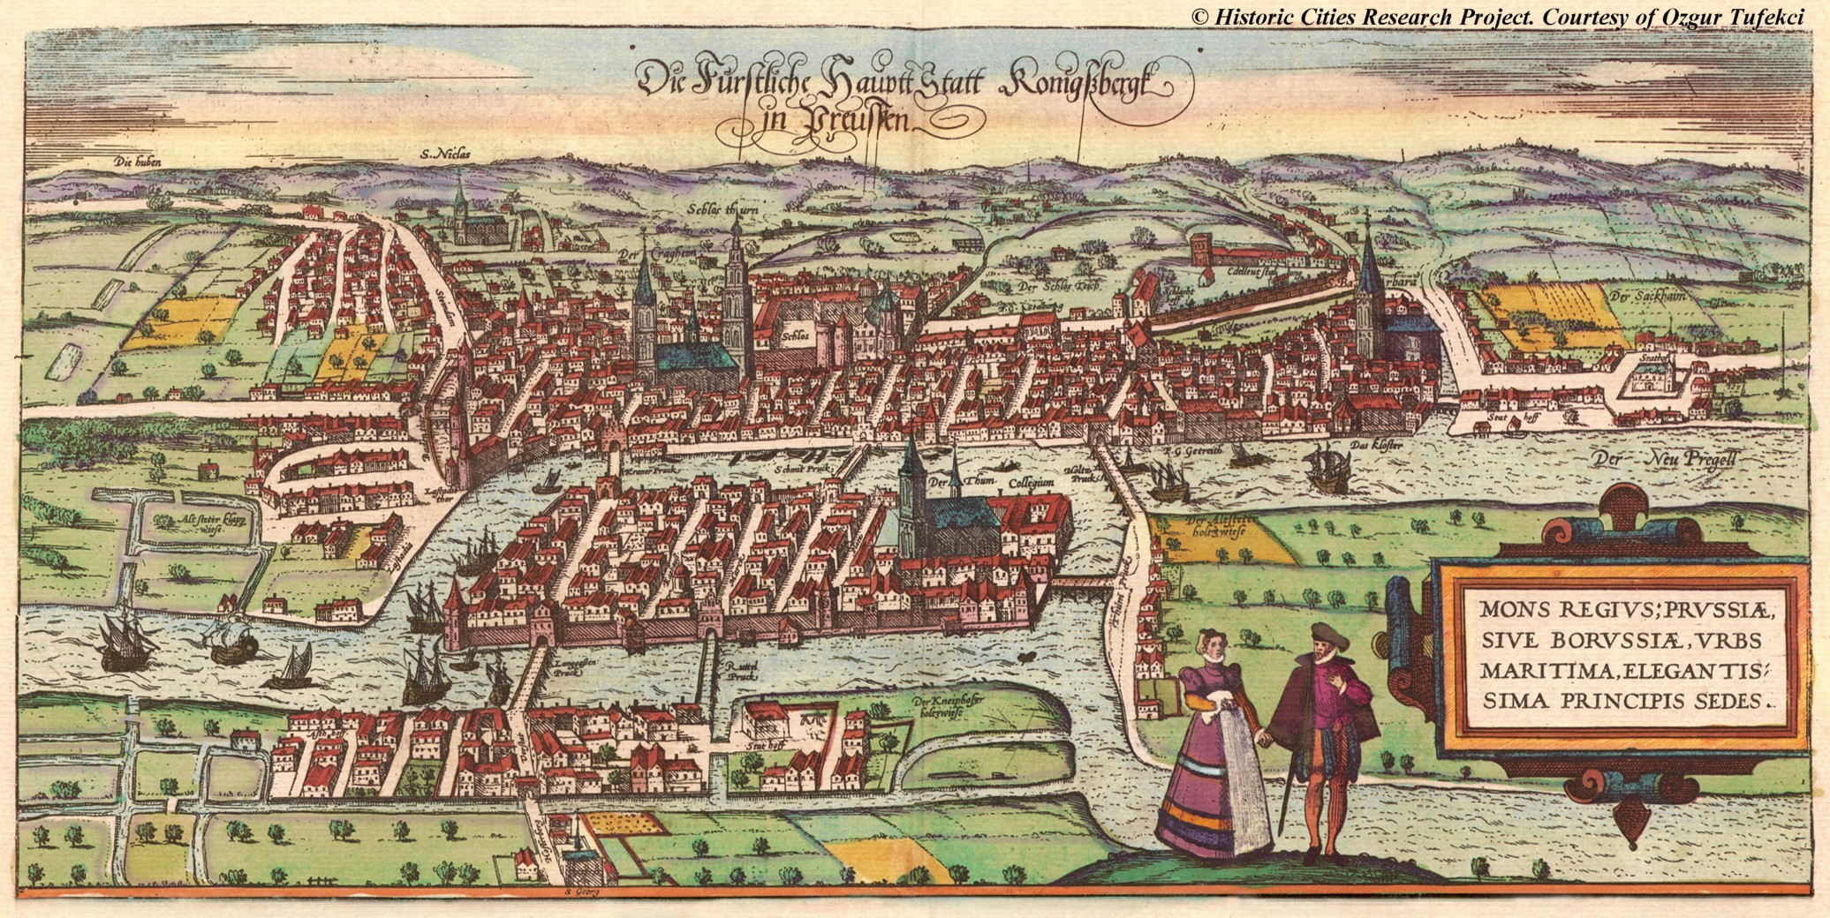
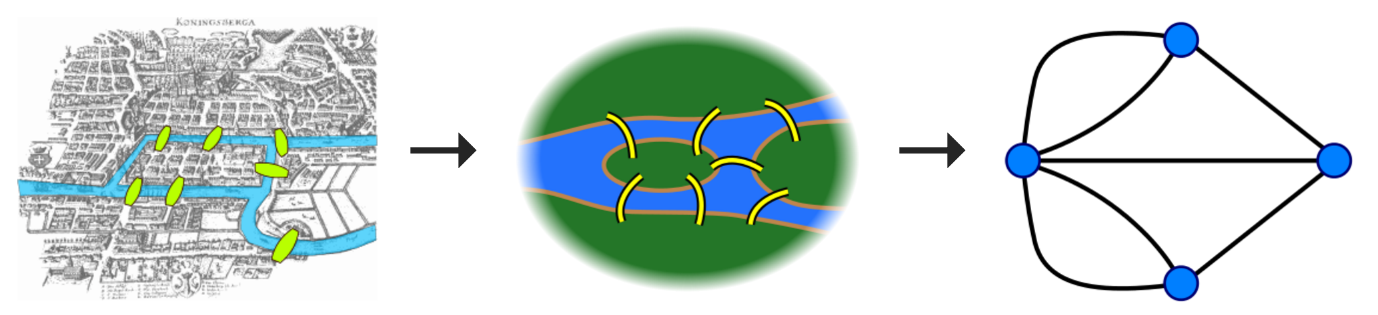
Algorithms

Slide 56

Twitter Popularity
1. Read a file of Twitter followers:
id1 id2
id1 id2
2. Rank users by the number of followers of followers.

Slide 57
BasicGraph exercise
* Start follows finish

Slide 58
Twitter Network
* Finish follows start

Slide 59
Twitter Network
* Finish follows start

Slide 60
First Degree Followers
* Finish follows start

Slide 61
Second Degree Followers
* Finish follows start

Slide 62
Twitter Graph
* Finish follows start

Slide 63
Twitter Graph
* Finish follows start

Slide 64
First Degree Followers
* Finish follows start

Slide 65
Second Degree Followers
* Finish follows start

Slide 66
Twitter Popularity
1. Read a file of Twitter followers:
id1 id2
id1 id2
2. Rank users by the number of followers of followers.

Slide 67
Today’s Route
Friday
Lover
Twitter
Graphs n
C++
Graphs
Graph River

Slide 68
Today’s Route
Friday
Lover
Twitter
Graphs n
C++
Graphs
Graph River

Slide 69
Who Do You Love
And how does Facebook know?

Slide 70
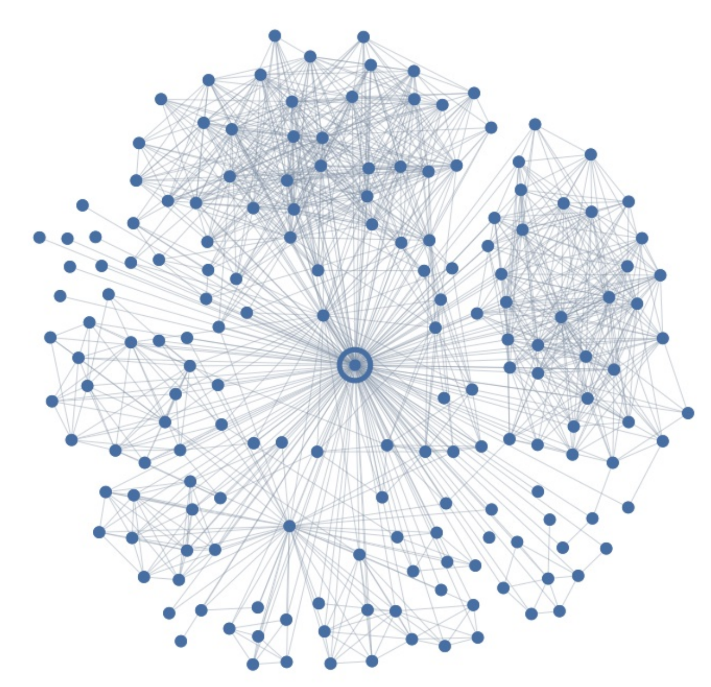
Who Do You Love?

Slide 71
Who Do You Love?

Slide 72
Who Do You Love?
Your significant other
376

Slide 73
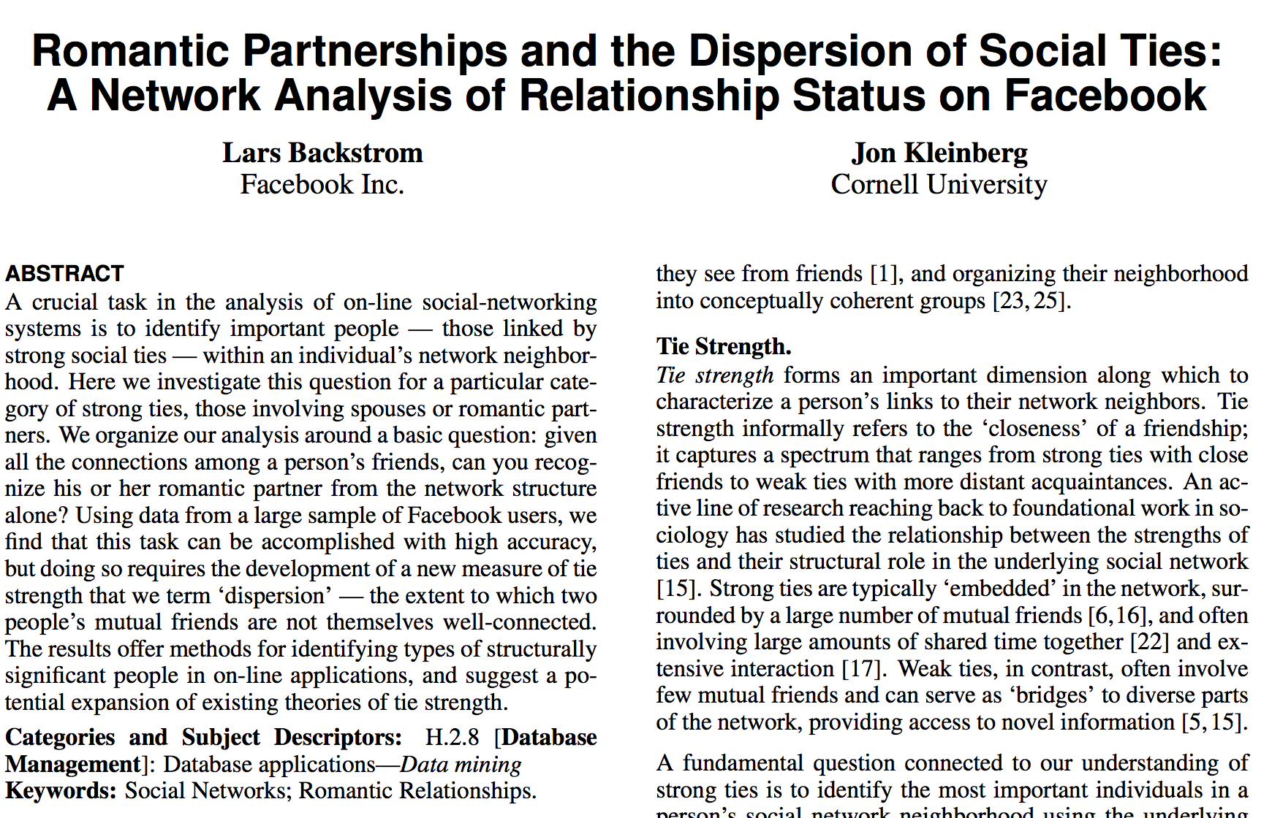
Romance and Dispersion
October 2013
http://arxiv.org/pdf/1310.6753v1.pdf

Slide 74
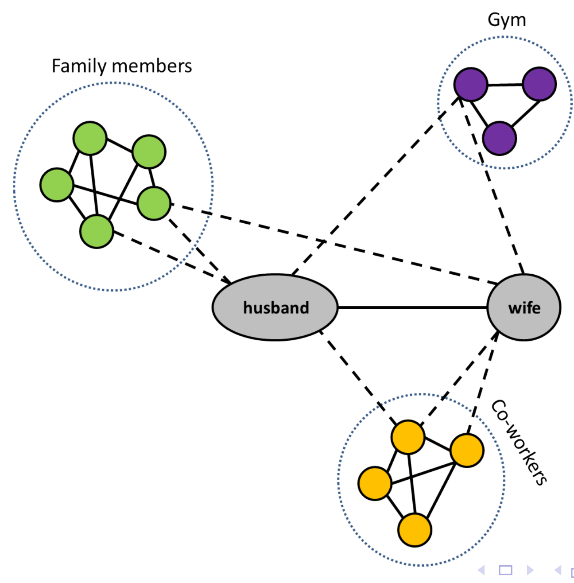
Dispersion Insight
Dispersion: The extent to which two people’s
mutual friends are not directly connected

Slide 75
Dispersion
Mutual
Friends
You
Testee
Dispersion: The extent to which two people’s
mutual friends are not directly connected

Slide 76
Dispersion
Mutual
Friends
You
Testee
Dispersion: The extent to which two people’s
mutual friends are not directly connected

Slide 77
Dispersion
Mutual
Friends
Dispersion: 0
You
Testee
Dispersion: The extent to which two people’s
mutual friends are not directly connected

Slide 78
Dispersion
Mutual
Friends
Dispersion: 1
You
Testee
Dispersion: The extent to which two people’s
mutual friends are not directly connected

Slide 79
Dispersion
Mutual
Friends
Dispersion: 2
You
Testee
Dispersion: The extent to which two people’s
mutual friends are not directly connected

Slide 80
Dispersion
Mutual
Friends
Dispersion: 3
You
Testee
Dispersion: The extent to which two people’s
mutual friends are not directly connected

Slide 81
Dispersion
Mutual
Friends
Dispersion: 4
You
Testee
Dispersion: The extent to which two people’s
mutual friends are not directly connected

Slide 82
Dispersion
Mutual
Friends
Dispersion: 5
You
Testee
Dispersion: The extent to which two people’s
mutual friends are not directly connected

Slide 83
Dispersion
Mutual
Friends
Dispersion: 5
You
Testee
Dispersion: The extent to which two people’s
mutual friends are not directly connected

Slide 84
Who Do You Love?
Your significant other
376

Slide 85
Today’s Route
Friday
Lover
Twitter
Graphs n
C++
Graphs
Graph River

Slide 86
Today’s Route
Friday
Lover
Twitter
Graphs n
C++
Graphs
Graph River

Slide 87
Today’s Goal
Introduction to Graphs
Graphs in C++

Slide 88

Page Rank

